Slide 1
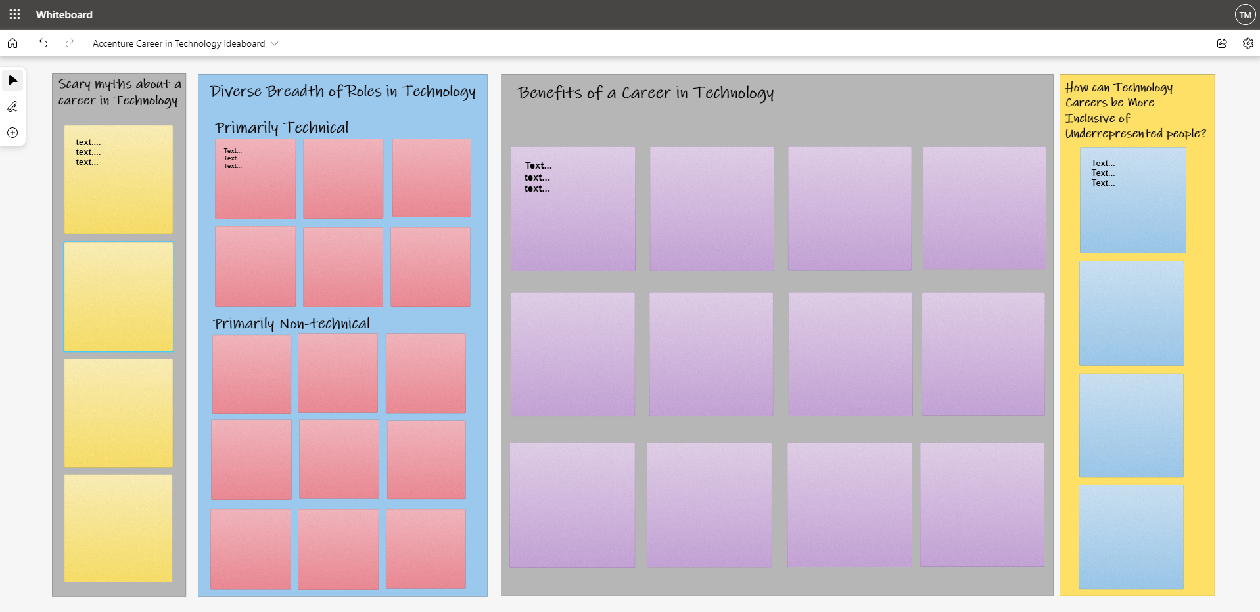
Example of Microsoft Whiteboard –based Ideaboard for Capturing Ideas about Careers in Technology

